Slide 1

Assembly Language Programming: 2. Basic
Prepared by:
Md. Jahidul Islam (Lecturer, Dept. of CSE, UIU.)
Special Thanks to:
Muhammad Tasnim Mohiuddin (Lecturer, Dept. of CSE, UIU.)
April 2015.
Department of Computer Science & Engineering (CSE), United International University (UIU).

Slide 2
Number System
Consists of TWO Things:
A BASE
A SET of DIGITS
Digits are symbols representing all values less than the radix value.
Example is the Common Decimal System:
RADIX (BASE) = 10
Digit Set = {0, 1, 2, 3, 4, 5, 6, 7, 8, 9}
April 2015.
Department of Computer Science & Engineering (CSE), United International University (UIU).

Slide 3
Common Bases
Binary
Radix = (2)₁₀
Digit Set = {0, 1}
Octal
Radix = (8)₁₀
Digit Set = {0, 1, 2, 3, 4, 5, 6, 7}
Hexadecimal
Radix = (16)₁₀
Digit Set = {0, 1, 2, 3, 4, 5, 6, 7, 8, 9, A, B, C, D, E, F}
April 2015.
Department of Computer Science & Engineering (CSE), United International University (UIU).

Slide 4
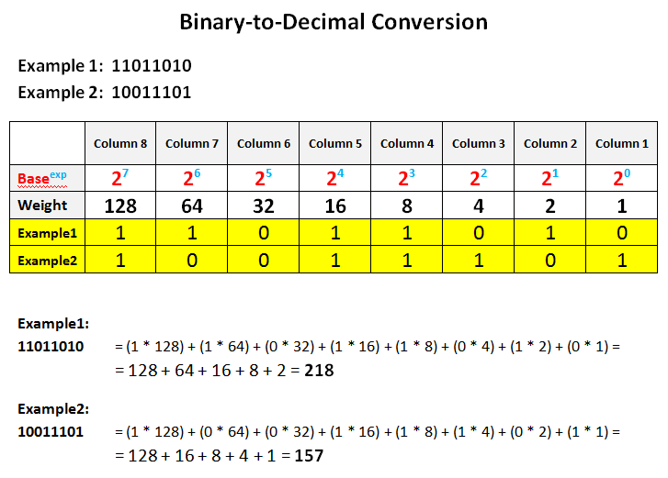
Binary to Decimal
April 2015.
Department of Computer Science & Engineering (CSE), United International University (UIU).

Slide 5
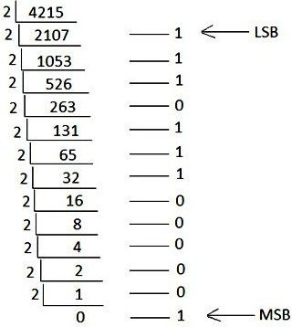
Decimal to Binary
4215 d = 1000001110111 b
April 2015.
Department of Computer Science & Engineering (CSE), United International University (UIU).

Slide 6
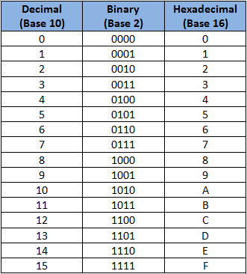
Class Work
Binary to Hexadecimal
Hexadecimal to Binary
Decimal to Hexadecimal
Hexadecimal to Decimal
Addition and Subtraction of:
Hexadecimal numbers
April 2015.
Department of Computer Science & Engineering (CSE), United International University (UIU).

Slide 7
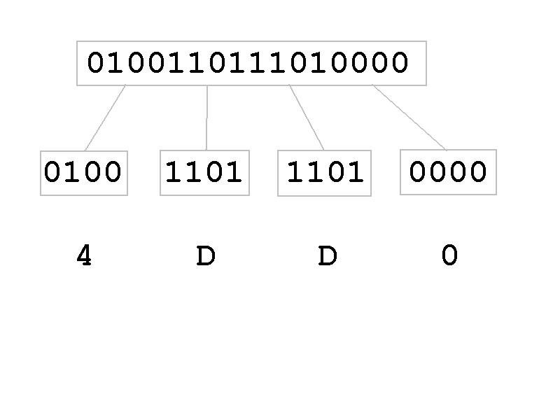
Class Work (contd.)
Binary to/from Hexadecimal
April 2015.
Department of Computer Science & Engineering (CSE), United International University (UIU).

Slide 8
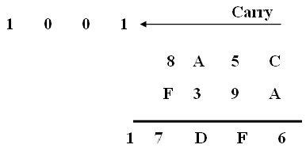
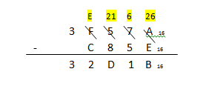
Class Work (contd.)
Adding and Subtracting two hexadecimal numbers
April 2015.
Department of Computer Science & Engineering (CSE), United International University (UIU).

Slide 9
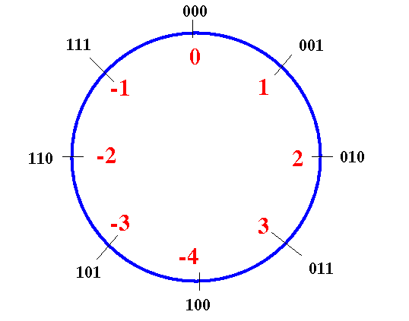
2’s Complement
Negative number representation in 3 bit
April 2015.
Department of Computer Science & Engineering (CSE), United International University (UIU).

Slide 10
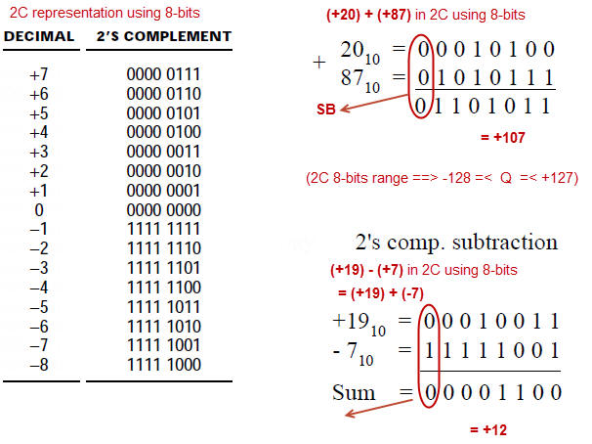
2’s Complement (contd.)
Negative number representation in 8 bit
April 2015.
Department of Computer Science & Engineering (CSE), United International University (UIU).

Slide 11
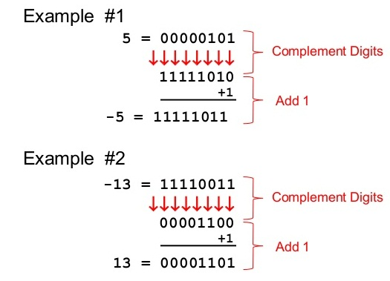
2’s Complement (contd.)
2’s complement = 1’s complement + 1
April 2015.
Department of Computer Science & Engineering (CSE), United International University (UIU).

Slide 12
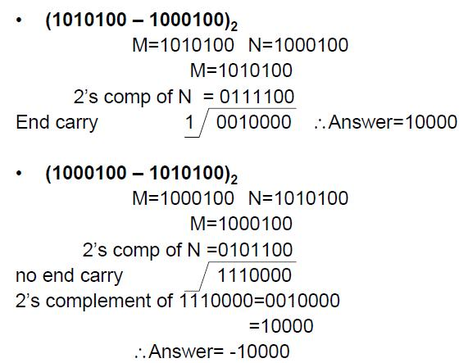
Subtraction Using 2’s Complement
April 2015.
Department of Computer Science & Engineering (CSE), United International University (UIU).

Slide 13
Test Your Skill
Find the 2’s complement of (27)₁₀ and (47)₁₀
(79)₁₀ = ( ? )₁₆ = ( ? )₂ = ( ? )₈ = ( ? )₄ = ( ? )₅
What is the maximum & minimum number that can be represented in an 8 bit binary number system? (For both signed and unsigned number).
If A = 3F H, B = 8A H, and C = A – B then, what is the value of C?
In which base, the following operation is correct?
24 + 45 = 113
Convert the decimal 187 to 8 bit binary number.
What is the two's complement of value 1110 0111?
Output the result of (23)₈ - (46)₇ in hexadecimal.
April 2015.
Department of Computer Science & Engineering (CSE), United International University (UIU).

Slide 14
Data Representation
Number | Representation
11011 | decimal
11011B | binary
64223 | decimal
-21843D | decimal
1B4DH | hexadecimal
1B4D | invalid
FFFFH | invalid
0FFFFH | hexadecimal
April 2015.
Department of Computer Science & Engineering (CSE), United International University (UIU).

Slide 15
Data Representation (contd.)
Characters
Must be enclosed in single or double quotes:
“Hello”, ‘Hello’, “A”, ‘B’
Translated into ASCII code by the assembler:
‘A’ has ASCII code 41H
‘a’ has ASCII code 61H
‘0’ has ASCII code 30H
Line feed has ASCII code 0AH
Carriage Return has ASCII code 0DH
Back Space has ASCII code 08H
Horizontal tab has ASCII code 09H
April 2015.
Department of Computer Science & Engineering (CSE), United International University (UIU).

Slide 16
Variable Declaration
Data-defining pseudo-ops
DB define byte
DW define word
DD define double word (two consecutive words)
DQ define quad word (four consecutive words)
DT define ten bytes (five consecutive words)
April 2015.
Department of Computer Science & Engineering (CSE), United International University (UIU).

Slide 17
Byte Variables
name DB initial value
I DB 4 ; define variable I with initial value 4
J DB ? ; define variable J with uninitialized value
Byte Array
K DB 5, 3, -1 ; allocates 3 bytes
K
05
03
FF
April 2015.
Department of Computer Science & Engineering (CSE), United International University (UIU).

Slide 18
Word Variables
name DW initial value
I DW 4
J DW -2
K DW 0ABCH
L DW “01”
I
04
00
J
FE
FF
K
BC
0A
L
31
30
April 2015.
Department of Computer Science & Engineering (CSE), United International University (UIU).

Slide 19
Double Word Variables
name DD initial value
I DD 1FE2AB20H
J DD -4
I
20
AB
E2
1F
J
FC
FF
FF
FF
April 2015.
Department of Computer Science & Engineering (CSE), United International University (UIU).

Slide 20
Named Constants
EQU pseudo-op used to assign a name to constant.
No memory allocated for EQU names.
Example
LF EQU 0AH
MOV DL, 0AH
MOV DL, LF
PROMPT EQU “Type your name”
MSG DB “Type your name”
MSG DB PROMPT
April 2015.
Department of Computer Science & Engineering (CSE), United International University (UIU).

Slide 21
Few Basic Instruction
Over 100 instructions for 8086
Today we will discuss few most useful ones:
MOV
XCHG
ADD
SUB
INC
DEC
NEG
April 2015.
Department of Computer Science & Engineering (CSE), United International University (UIU).

Slide 22
MOV Instruction
Syntax: MOV destination, source
Transfer data between
Two registers
A register and a memory location
A constant to a register or memory location
April 2015.
Department of Computer Science & Engineering (CSE), United International University (UIU).

Slide 23
MOV Instruction (contd.)
Destination Operand
 | General register | Segment register | Memory location | Constant
General register | Yes | Yes | Yes | Yes
Segment register | Yes | No | Yes | No
Memory location | Yes | Yes | No | Yes
Source Operand
April 2015.
Department of Computer Science & Engineering (CSE), United International University (UIU).

Slide 24
MOV Instruction (contd.)
MOV instruction has no effect on flags.
Examples:
MOV DS, @Data illegal MOV DS, [BX] legal
MOV AX, [SI] legal MOV DS, ES illegal
MOV [BX-1], DS legal MOV [BX], -1 illegal
MOV [DI], [SI] illegal MOV AL, offset I illegal
MOV [BX], offset I illegal MOV [SI], I illegal
April 2015.
Department of Computer Science & Engineering (CSE), United International University (UIU).

Slide 25
XCHG Instruction
Syntax: XCHG destination, source
Exchanges contents of two registers, or a register and a memory location.
XCHG has no effect on flags.
Destination Operand
 | General Register | Memory Location
General Register | yes | yes
Memory Location | yes | no
Source Operand
April 2015.
Department of Computer Science & Engineering (CSE), United International University (UIU).

Slide 26
ADD & SUB Instructions
Syntax:
ADD destination, source ; destination = destination+ source
SUB destination, source ; destination = destination-source
ADD and SUB instructions affect all the flags.
 | General register | Memory location | Constant
General register | Yes | Yes | Yes
Memory location | Yes | No | Yes
April 2015.
Department of Computer Science & Engineering (CSE), United International University (UIU).

Slide 27
INC & DEC Instructions
Syntax:
INC operand ; operand = operand + 1
DEC operand ; operand = operand - 1
Operand can be a general register or memory.
INC and DEC instructions affect all the flags.
April ,2015.
Department of Computer Science & Engineering (CSE), United International University (UIU).

Slide 28
NEG instruction
Syntax: NEG operand
Finds the two’s complement of operand.
Operand can be a general register or memory location.
NEG instruction affects all flags.
April 2015.
Department of Computer Science & Engineering (CSE), United International University (UIU).

Slide 29
Program Segments
Machine Programs consists of
Code
Data
Stack
Each part occupies a memory segment.
Same organization is reflected in an assembly language program as Program Segments.
Each program segment is translated into a memory segment by the assembler.
April 2015.
Department of Computer Science & Engineering (CSE), United International University (UIU).

Slide 30
Memory Models
Determines the size of data and code a program can have.
Syntax: .MODEL memory_model
Model | Description
SMALL | code in one segment, data in one segment
MEDIUM | code in more than one segment, data in one segment
COMPACT | code in one segment, data in more than one segment
LARGE | Both code and data in more than one segments No array larger than 64KB
HUGE | Both code and data in more than one segments array may be larger than 64KB
April 2015.
Department of Computer Science & Engineering (CSE), United International University (UIU).

Slide 31
Data Segment
All variable definitions
Use .DATA directive
For Example:
.DATA
WORD1 DW 2
BYTE1 DB 10h
April 2015.
Department of Computer Science & Engineering (CSE), United International University (UIU).

Slide 32
Stack Segment
A block of memory to store stack
Syntax:
.STACK size
Where size is optional and specifies the stack area size in bytes
If size is omitted, 1 KB set aside for stack area
For example:
.STACK 100h
April 2015.
Department of Computer Science & Engineering (CSE), United International University (UIU).

Slide 33
Code Segment
Contains a program’s instructions
Syntax:
.CODE name
Where name is optional
Do not write name when using SMALL as a memory model
April 2015.
Department of Computer Science & Engineering (CSE), United International University (UIU).

Slide 34
Putting it all together!
.MODEL SMALL
.STACK 100h
.DATA
;data definition go here
.CODE
MAIN PROC ; Main Procedure starts here
;instructions go here
MAIN ENDP ; Main Procedure ends here
END MAIN
April 2015.
Department of Computer Science & Engineering (CSE), United International University (UIU).

Slide 35
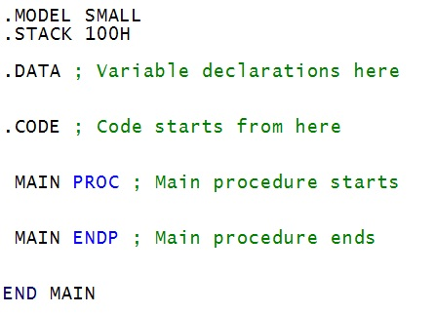
Starting to code: Template.asm
April ,2015.
Department of Computer Science & Engineering (CSE), United International University (UIU).

Slide 36
I/O Instructions
The instruction INT 21H transfers control to the operating system, to a subprogram that handles I/O operations.
AH = 1 is used for input
The AL register stores the input character
AH = 2 is used for output
Console shows the value stored in DL
April ,2015.
Department of Computer Science & Engineering (CSE), United International University (UIU).

Slide 37
Details: input
For character input from keyboard, the number 1 must be stored in the AH register. (MOV AH, 1H )
Then we call the INT 21H. (INT 21H)
The DOS subprogram stores the input in AL register.
MOV AH, 1 ; calling the input subroutine
INT 21H ; input goes to AL
MOV BL, AL ; Saving the input to BL
April ,2015.
Department of Computer Science & Engineering (CSE), United International University (UIU).

Slide 38
Details: output
For character input from keyboard, the number 2 must be stored in the AH register. (MOV AH, 2H )
Then we call the INT 21H. (INT 21H)
The DOS subprogram shows the value of DL register to the console.
MOV DL, BL
MOV AH, 2 ; calling the output subroutine
INT 21H ; console shows the value stored in DL
April ,2015.
Department of Computer Science & Engineering (CSE), United International University (UIU).

Slide 39
An Example for basic I/O
MOV AH, 1 ; calling the input subroutine
INT 21H ; input goes to AL
MOV BL, AL ; Saving the input to BL
MOV DL, BL
MOV AH, 2 ; calling the output subroutine
INT 21H ; console shows the value stored in DL
April ,2015.
Department of Computer Science & Engineering (CSE), United International University (UIU).

Slide 40
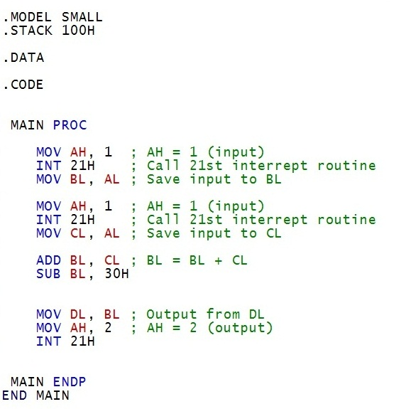
Our First Code: add sub.asm
April ,2015.
Department of Computer Science & Engineering (CSE), United International University (UIU).

Slide 41
Any Questions?
Thank You
April 2015.
Department of Computer Science & Engineering (CSE), United International University (UIU).

